Slide 1
Event Planning
Web-based Application
WebIt: Krishna Viradia, Courtney Burns, Sara Nazir, Wubnyonga Tete, Theresa Tomilson, Mehak Uddin, Nuri Ousman

Slide 2
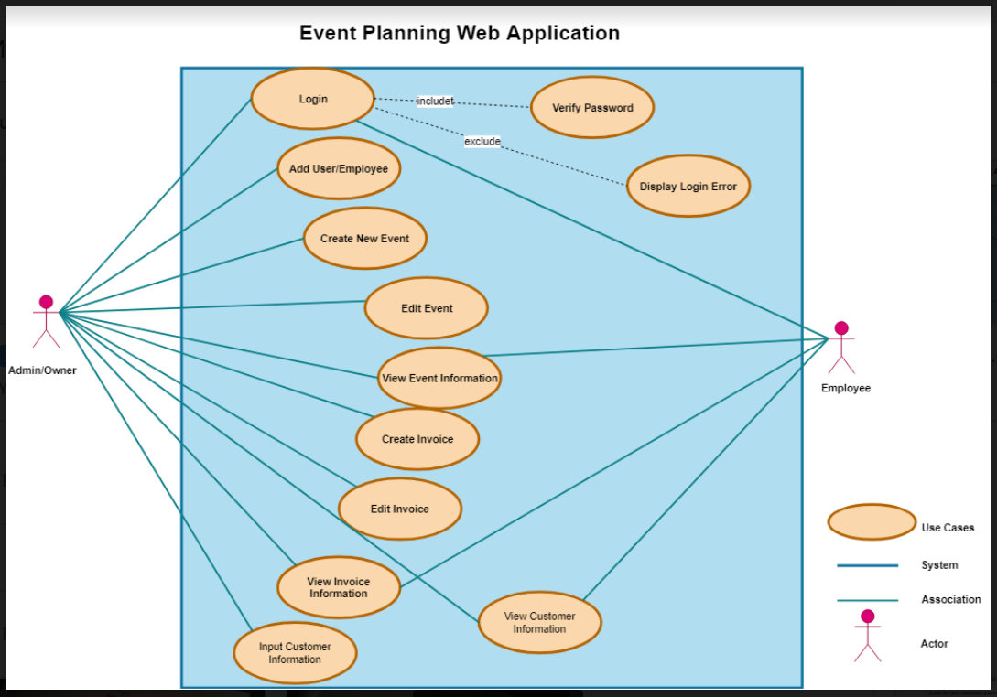
Revising Deliverable 2 Use Case diagram
Deliverable 2 use case

Slide 3
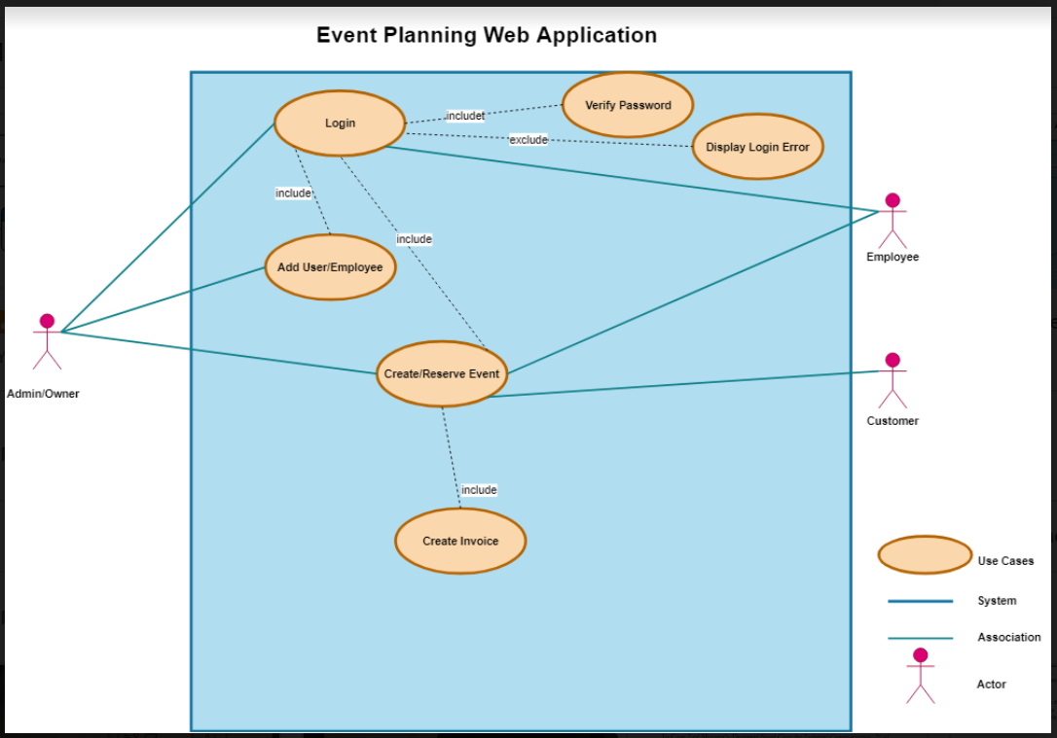
Revising Deliverable 2 Use Case diagram
New use case diagram

Slide 4
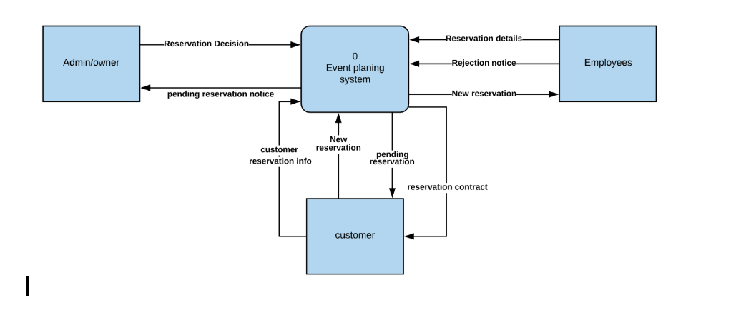
Context Diagram

Slide 5
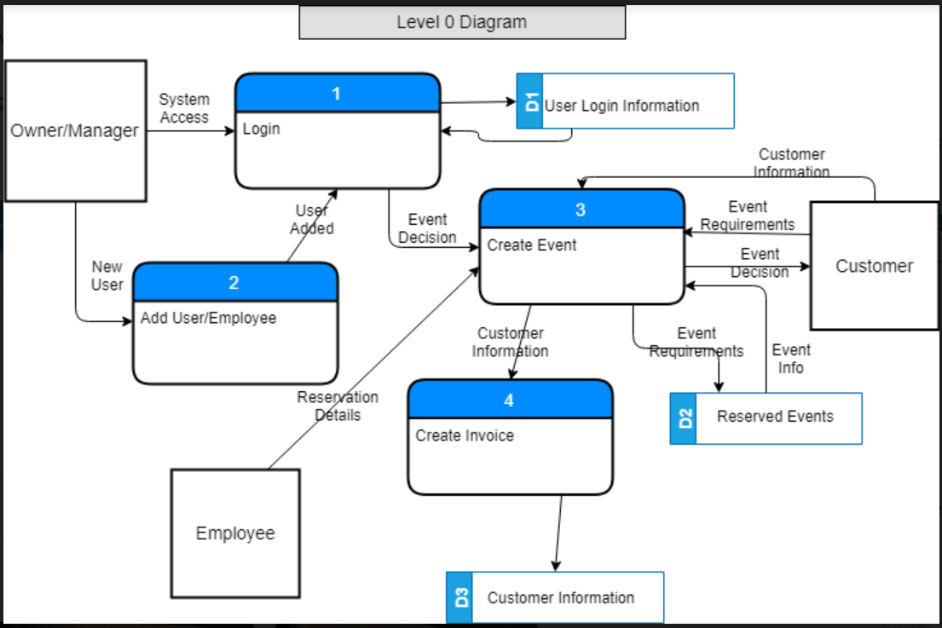
Level 0 Diagram

Slide 6
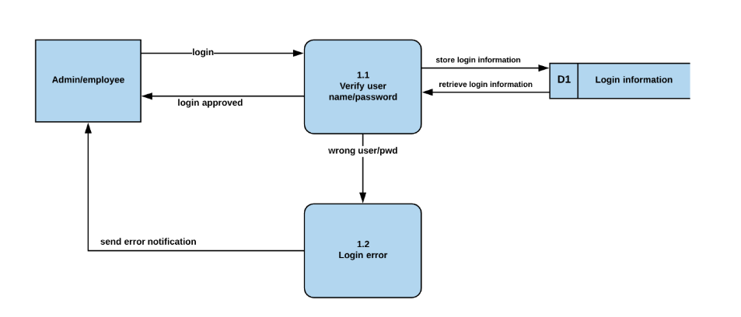
Process 1(login) -Level 1 Diagram

Slide 7
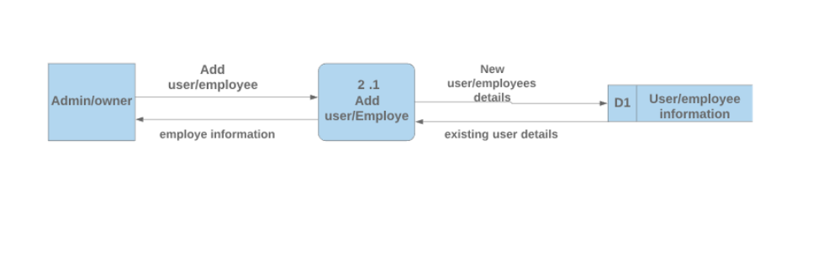
Process 2(Add user/employee) - Level 1 Diagram

Slide 8
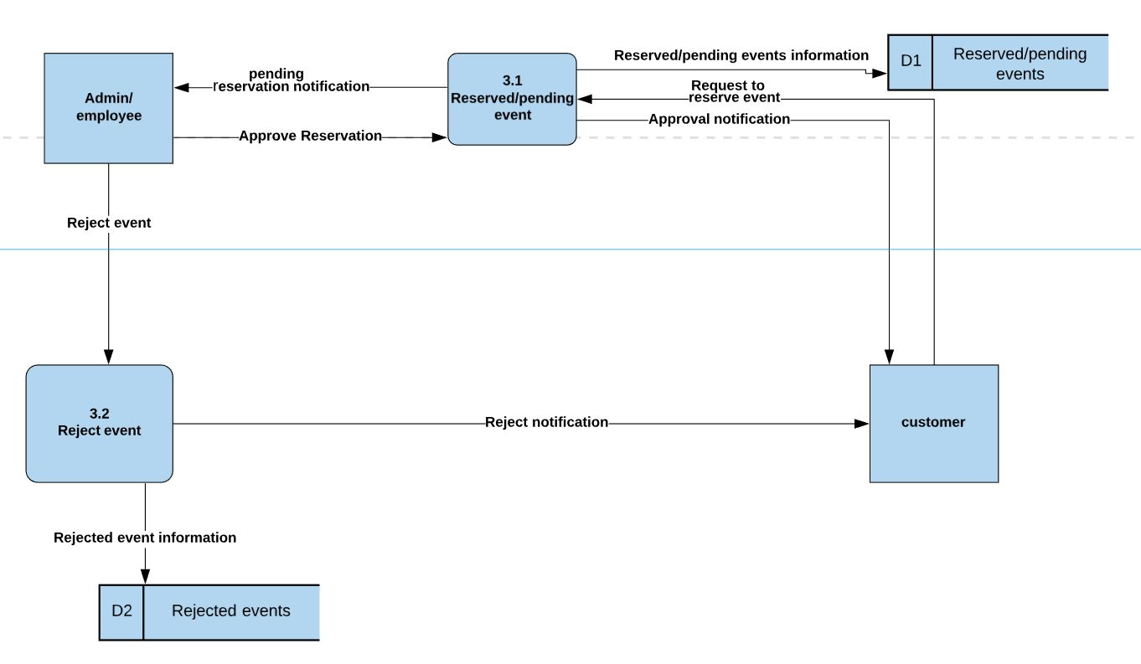
Process 3(create event) - Level 1 Diagram

Slide 9
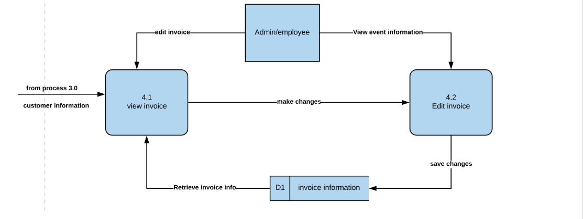
Process 4 (create invoice)- Level 1 Diagram

Slide 10
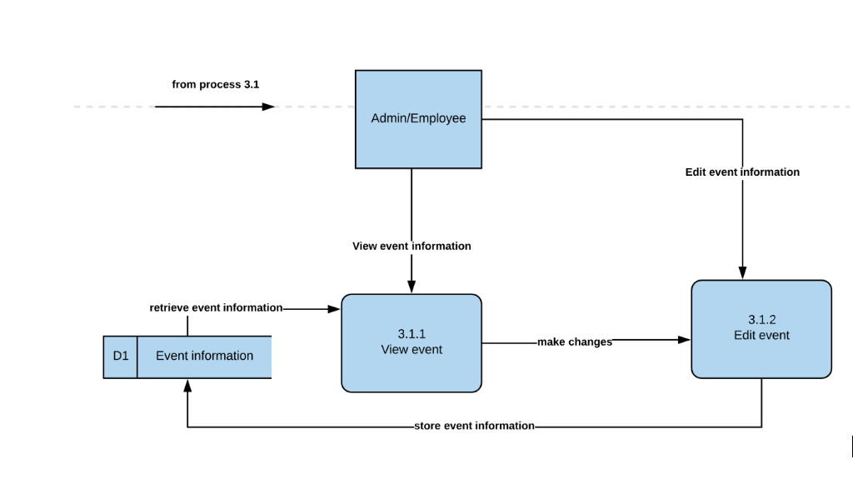
- Level 2 Diagram

Slide 11
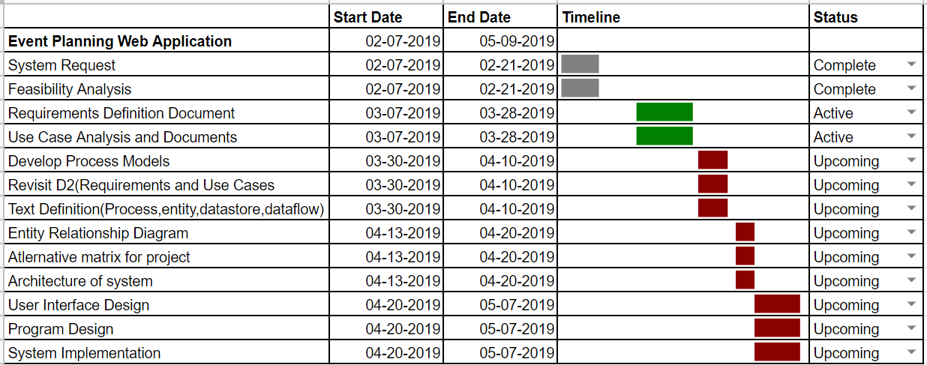
Gantt Chart

Slide 12
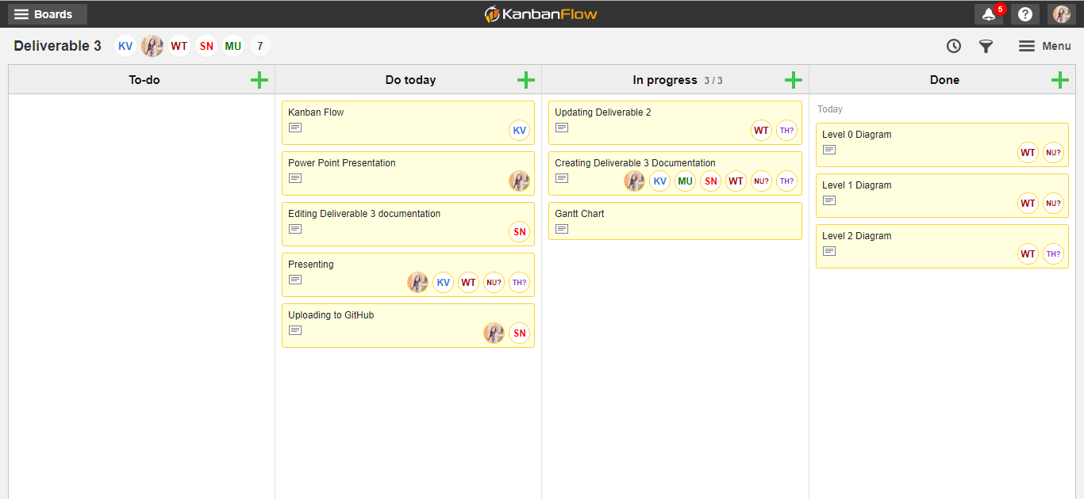
Kanban Flow

